Slide 1
Lecture 5
Random Variables
Discrete Distributions
Continuous Distributions

Slide 2

3.1 Random Variables and Discrete Distributions
A random variable is some function that assigns a real number X(s) to each possible outcome , where S is the sample space for an experiment.
  Discrete:
  e.g. Female=1, Male=0
  e.g. Satisfied=1, Average=0, Unsatisfied=-1
  Continuous: height, score, price
Notes:
What is the difference between the gender variable and the satisfaction score? (nominal vs ordinal)
Height, score, or price is discrete in practice, but we use continuous distribution as approximation.
The function from each possible outcome to a real number could be one to one, multiple to one, but not one to multiple.

Slide 3
Discrete Distribution
A complete description of a discrete random variable requires that we specify
the possible values the random variable can assume
the probability associated with each value.

Slide 4

Example: Coke vs Pepsi
Two people are surveyed about whether they prefer Coke or Pepsi. The sample space can be regarded as the set of different sequences.
Let X be the number of people who prefer Coke.
PP
PC
CP
CC
X(s)=0
X(s)=1
X(s)=2

Slide 5
Example: Coke vs Pepsi
Suppose that in some population, the probability of preferring Coke over Pepsi is 50%. Find the probability associated with each value of the random variable X. Display these values in a table or graph.

Slide 6
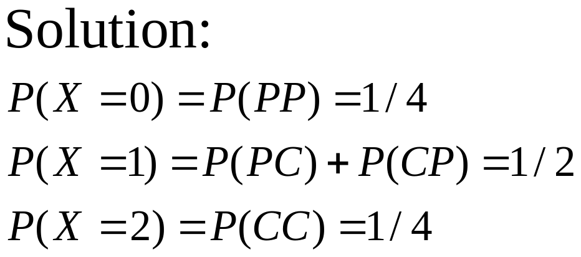
f (x)
Now we know the values the random variable can assume (0,1,2) and how the probability is distributed over these values (1/4,1/2,1/4). This completely describes the distribution of the random variable and is referred to as the probability function, denoted by the notation f(x).
1/2
1/4
x
0
1
2

Slide 7
Discrete Distributions
X has a discrete distribution if X can take only a finite number of different values x1,...,xk or, at most, an infinite sequence of different values x1,x2,...
The probability function (p.f.) of X is defined to be the function f such that for every real number x, f(x)=Pr(X=x).

Slide 8
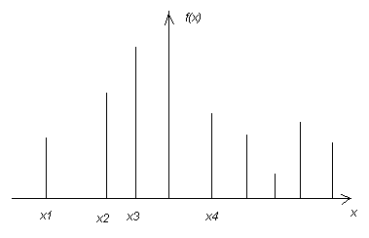
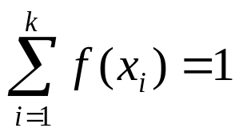
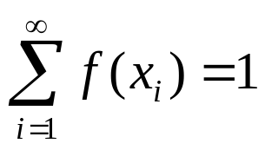
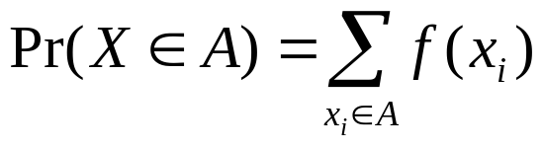
If x is not one of the possible values of X, f(x)=0.
We have or
If A is any subset of the real line,

Slide 9

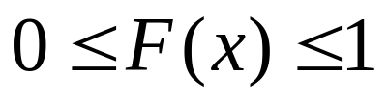
The Distribution Function
The distribution function of a random variable X is a function defined for each real number x:
Since F(x) is the probability of the event
At any point x,

Slide 10
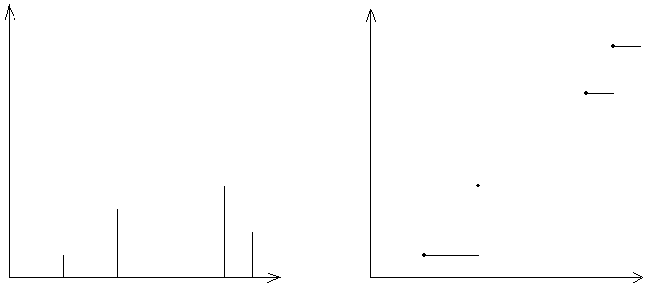
The d.f. of a Discrete Distribution
If a<b and if Pr(a<X<b)=0, then F(x) will be constant and horizontal over the interval a<X<b.
At every point x such that Pr(X=x)>0, the d.f. will jump by the amount Pr(X=x).
f(x)
F(x)
x
x

Slide 11
The Binomial Distribution
E.g. A machine produces a defective item with probability p (0<p<1) and produces a nondefective item with probability q=1-p.
n independent items are examined. Let X denote the number of these items that are defective. X can take values 0,1,2,...,n.

Slide 12
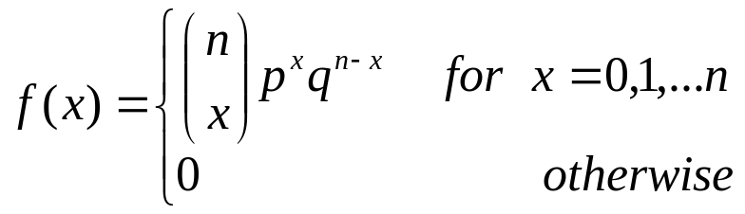
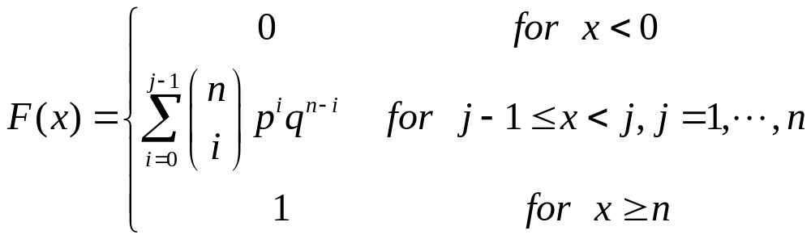
The Binomial Distribution
This discrete distribution is called Binomial distribution with parameters n and p.

Slide 13
3.2 Continuous Distributions
The distribution of monthly household income for a randomly selected peasant worker in Beijing.
The distribution of the value of Shanghai Composite Index at 15:00 tomorrow.

Slide 14
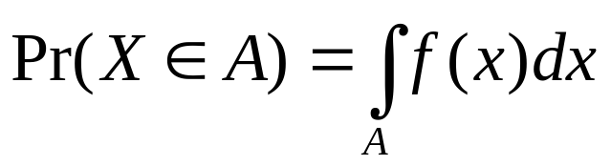
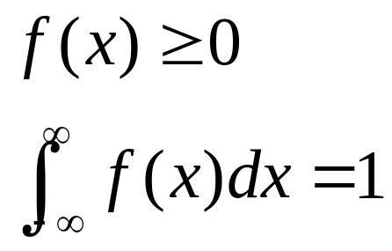
Continuous Distributions
X has a continuous distribution if there exists a nonnegative function f defined on the real line, s.t. for any subset A of the real line,
f is called the probability density function (p.d.f.) of X. Every p.d.f. must satisfy two requirements:

Slide 15
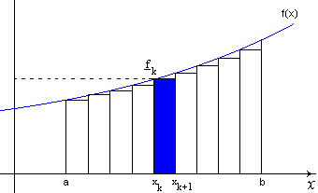
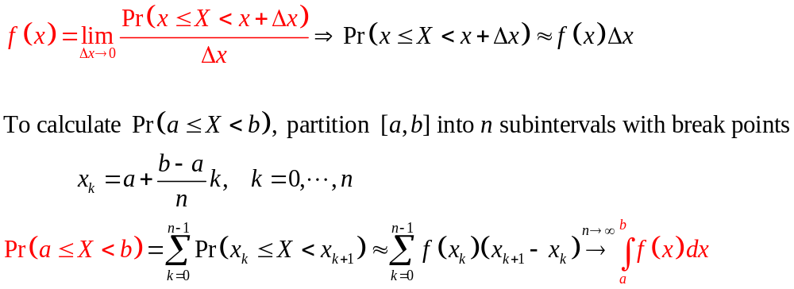
Understanding Probability Density Function

Slide 16
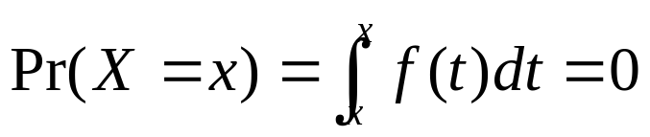
Probability for Individual Values
For every individual value x,
But X=x is not impossible.
So

Slide 17
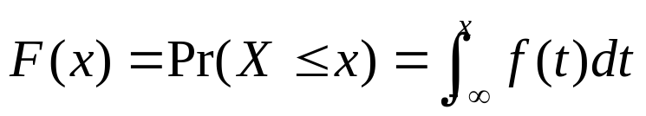
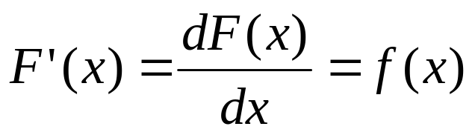
The d.f. of a Continuous Distribution
Suppose X has a continuous distribution with p.d.f. f(x). Since the probability of each individual point x is 0, the d.f. F(x) will have no jumps.
Furthermore,
at each point x at which f(x) is continuous,

Slide 18

Uniform Distribution on An Interval
a and b are two given real numbers such that a<b.
A point X is selected from the interval
The probability that X will belong to any subinterval of S is proportional to the length of that subinterval.
This distribution is called the uniform distribution on the interval (a,b).

Slide 19
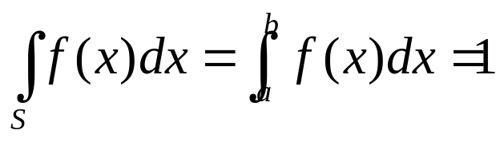
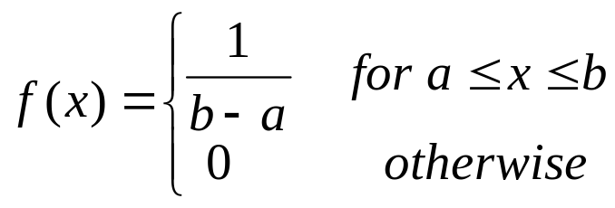
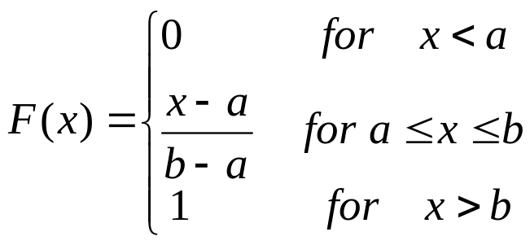
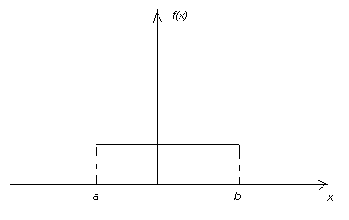
The p.d.f. f(x) of X must be 0 outside S.
f(x) must be constant throughout S.
Also,
The p.d.f. of X must be

Slide 20

The value of the constant is the reciprocal of the length of the interval.
It is not possible to define a uniform distribution over the interval because the length of this interval is infinite.
Since the probability is 0 at the endpoints a or b, it is irrelevant whether the distribution is regarded as a uniform distribution on [a,b], (a,b], [a,b) or (a,b).

Slide 21
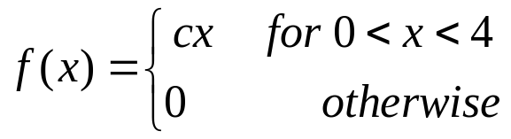
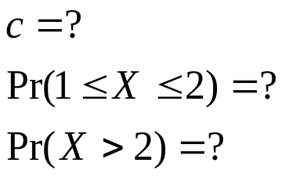
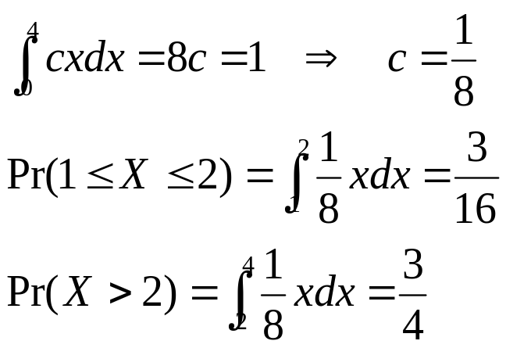
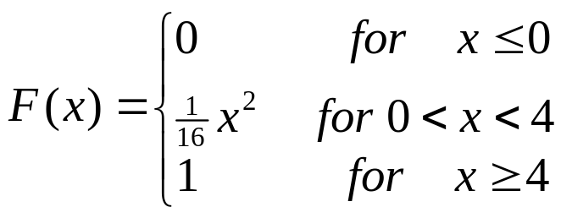
Example 3.2.3 Calculating Probabilities from a p.d.f.
The p.d.f. of a X has the following form:
Solution:
Note: c is often called the normalizing constant.
Its value is unique.

Slide 22
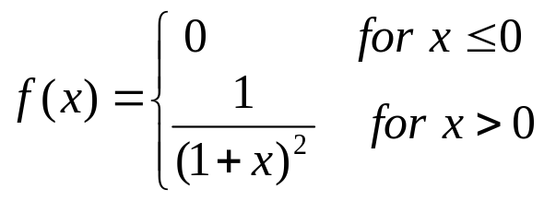
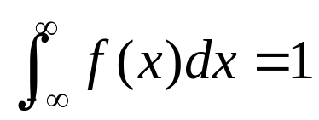
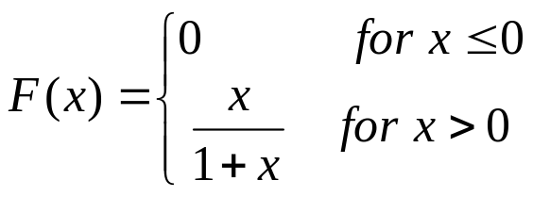
Example: Unbounded Random Variables
In an electrical system, the voltage X is a continuous random variable with p.d.f.
Verify that

Slide 23
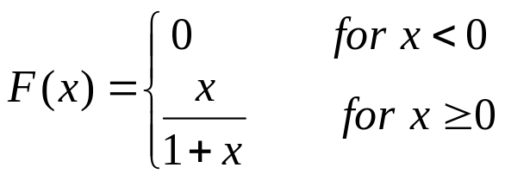
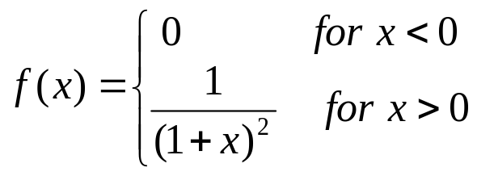
Example: Calculating a p.d.f. from a d.f.
In an electrical system, the voltage X is a random variable with the d.f. as follows:
F(x) is differentiable at every point except x=0. The p.d.f. of X can be found at any point other than x=0 by f(x)=dF(x)/dx.

Slide 24
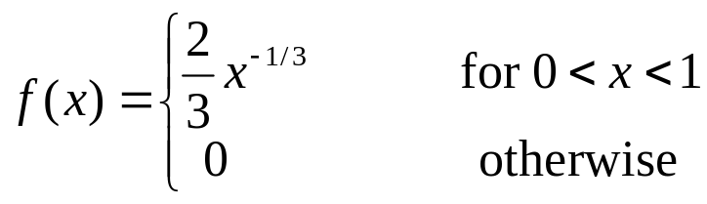
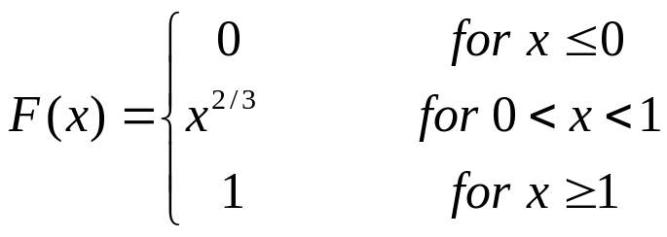
Example 3.2.5 Unbounded p.d.f.
Since a value of a p.d.f. is a probability density and not a probability, such a value can be larger than 1. The values of the following p.d.f. are unbounded in the neighborhood of x=0:
Verify that

